Slide 1
Safety Committee Meeting
April 28, 2022
10:00 AM

Slide 2
Review and Approval of Minutes
The January 27, 2022 meeting minutes were emailed yesterday.
Any suggested changes? If not, all in favor of October 27, 2022 minutes?

Slide 3
April is Distracted Driving Awareness Month!
Every day, eight people are killed and hundreds more are inured in distracted driving accidents.
Many of these accidents are caused by distracted driving and are preventable.
The moment your eyes leave the road and your attention is drawn to something else, you are distracted. Distractions can come from inside and outside your vehicle.

Slide 4
What is distracted driving?
Sending test messages or emails
Dialing a phone number
Talking on the phone or to a passenger
Eating or drinking
Using an entertainment or navigation system
Looking at a building or billboard.
Anything that causes our eyes and attention to move away from the road.

Slide 5
Tips to help you stay focused on the road
Check your itinerary and set up your navigation system before you begin driving.
Stay focused. Don’t let things outside of the vehicle distract you.
Don’t text. Texting is one of the most dangerous distractions. Never text while driving even if you are stopped in traffic or at a red light. Don’t read text messages you receive either.
Don’t dial a phone number. Instead try using hands-free phone controls.
Avoid eating and drinking while driving.
Put your cell phone on “do not disturb” mode while driving to avoid distraction.

Slide 6
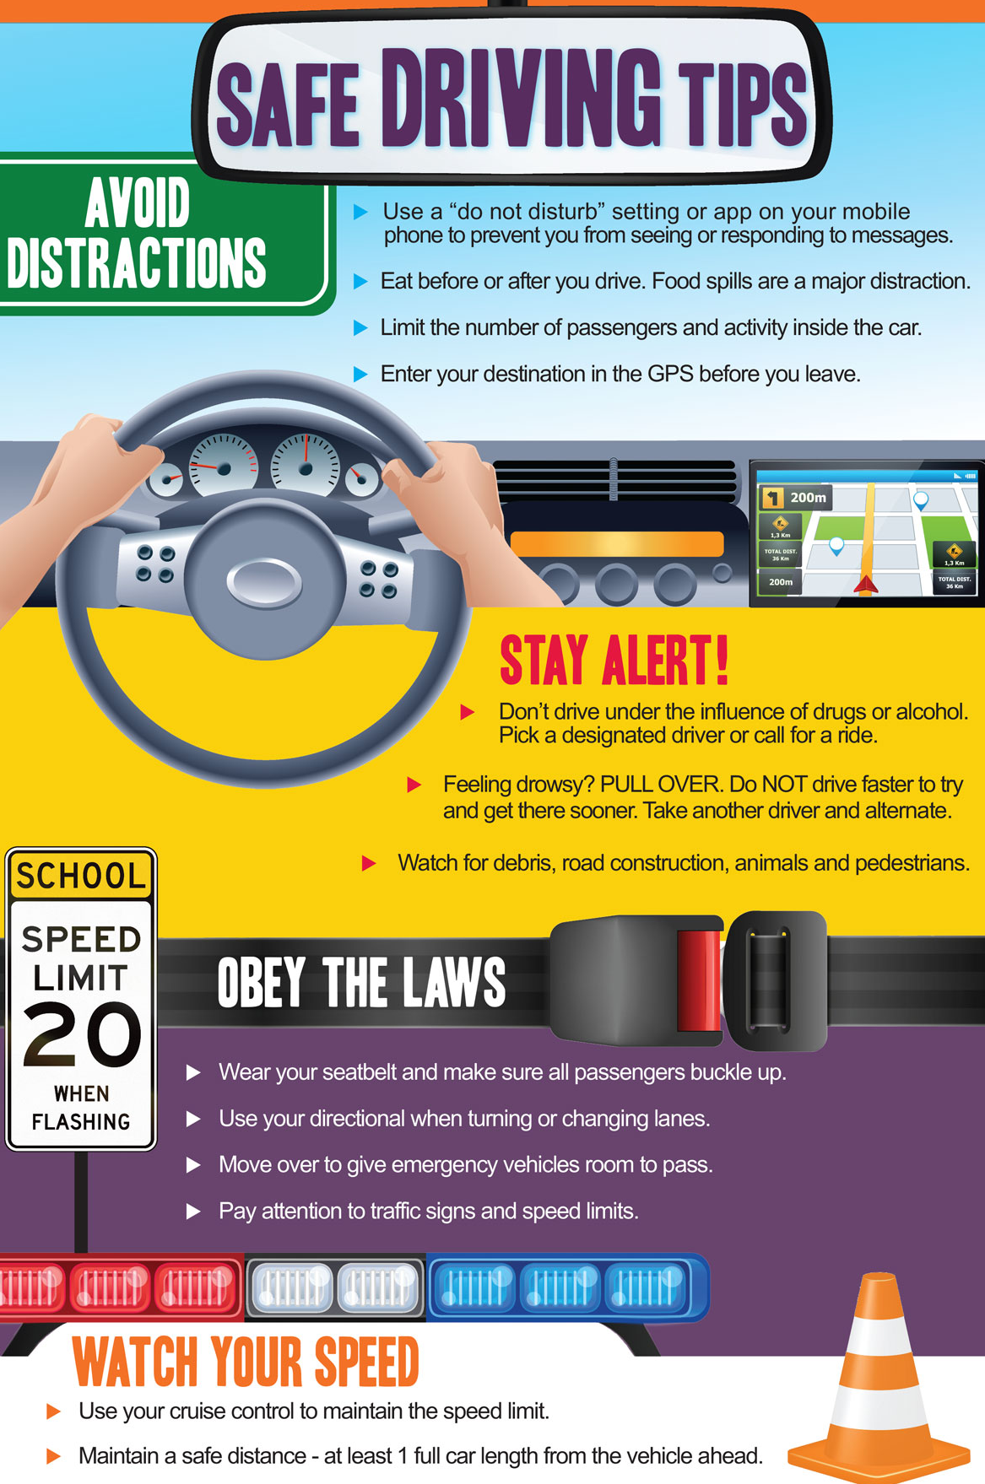

Slide 7
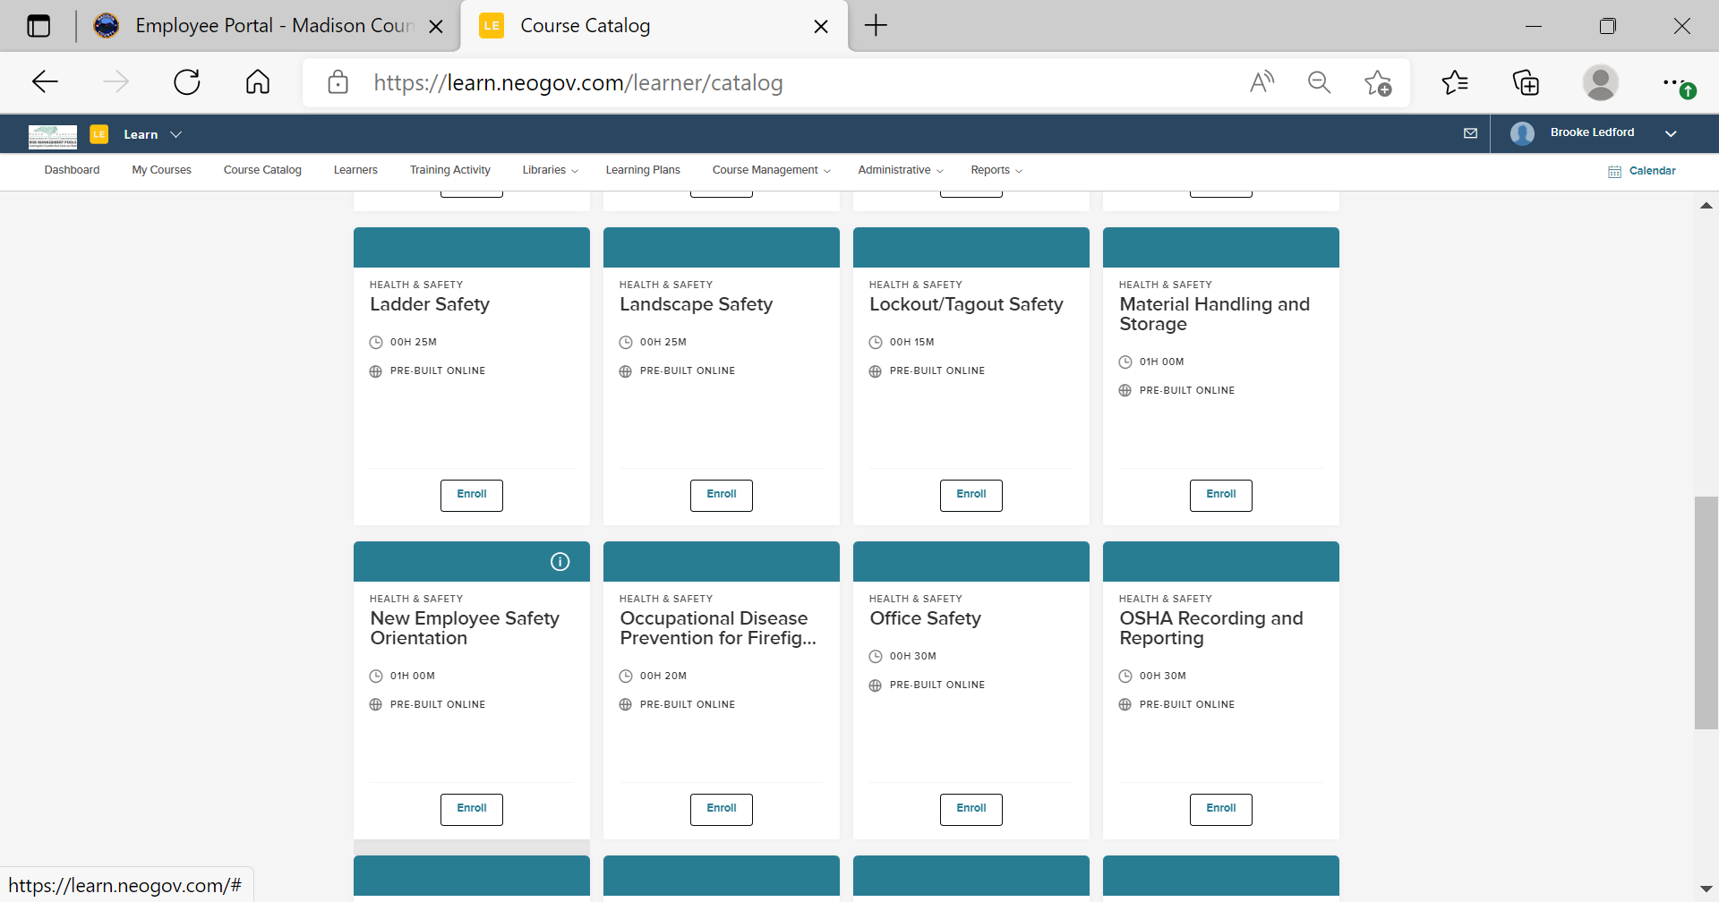
New NEOGOV Learn Platform
Madison County now has access to the NEOGOV Learn platform. This platform contains training videos and presentations for safety, supervisor training, customer service, and much more.
Recently, HR worked with the Transportation Department and provided their annual employee safety training.
If you would like to schedule your department for safety training, contact the Human Resources Office!

Slide 8
Accidents and Injury Reports
There have been three injuries reported in 2022.
The injuries are as follows:
Employee injured their finger when a door was closed on it.
Employee was injured when they jerked a piece of equipment and the equipment came back and hit them.
Employee slipped and fail on ice.
All of these injuries were preventable.
It is important to slow down and pay attention to our surroundings. Rushing through tasks will make employees more likely to slip, trip, or fall.
It is important to be observant and aware of surroundings. Check the surroundings for potential hazards before acting.
It is important for employees to complete tasks as safely as possible not as quickly or easily as possible.

Slide 9
Safety Info
Go to the employee portal on the County website at: https://www.madisoncountync.gov/employee-portal.html
Click on Safety Committee
Safety Committee Portal Password: Mad!s0n
Safety Committee email: safetycommittee@madisoncountync.gov

Slide 10
Open Discussion
Reminder, make sure you are completing your monthly building inspection forms!
Questions, comments?

